Slide 1
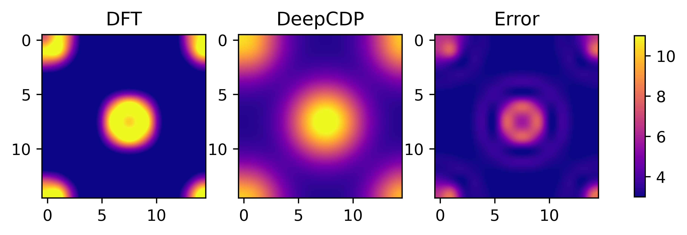
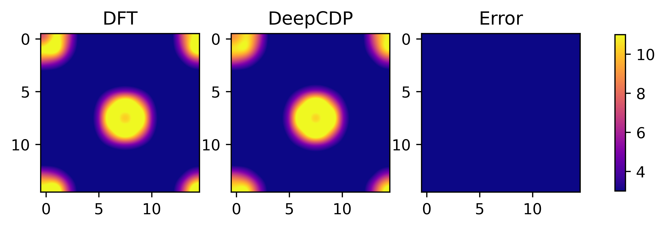
(a)
(b)

Slide 2
(a)
(b)
(c)

Slide 3
(a)
(b)

Slide 5
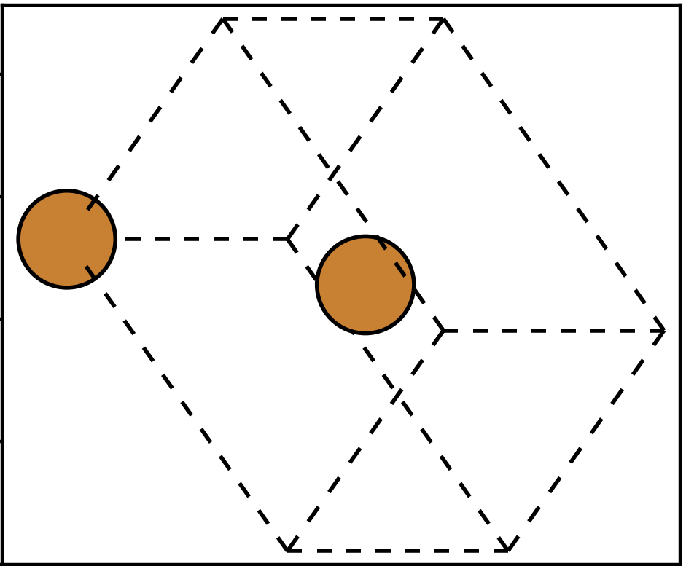
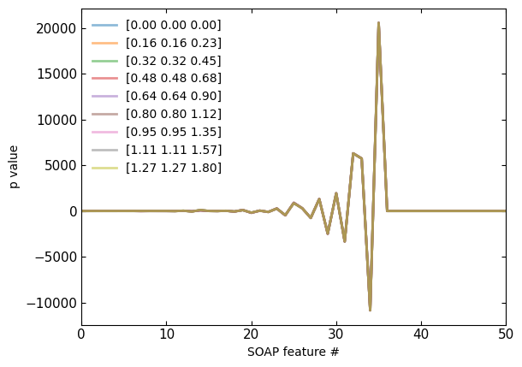
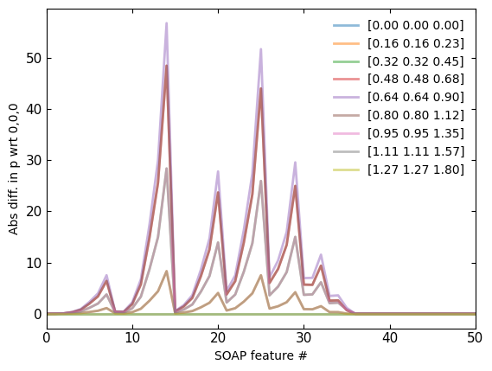
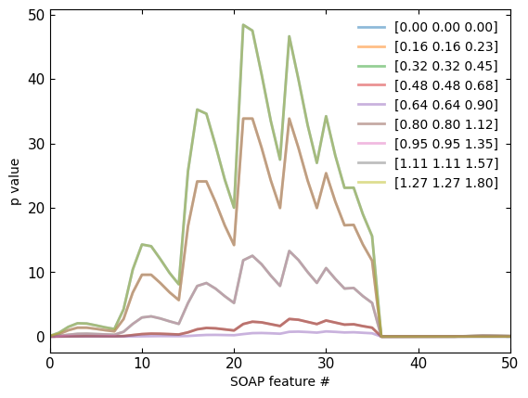
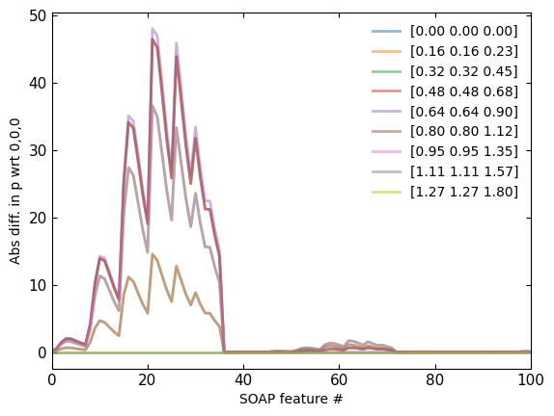
Non-weighted
Non-weighted
(b)
(c)
Weighted
Weighted
(d)
(e)
(a)

Slide 6
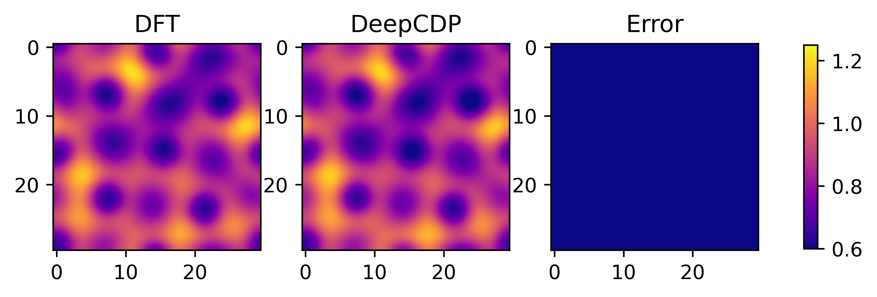
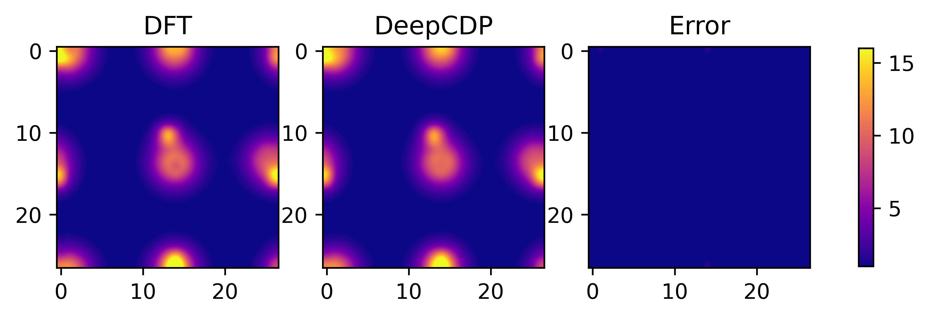
(a)
(b)

Slide 7
(d)
(e)

Slide 8
(a)
(b)
(c)

Slide 9
(a)
(b)
(c)

Slide 10
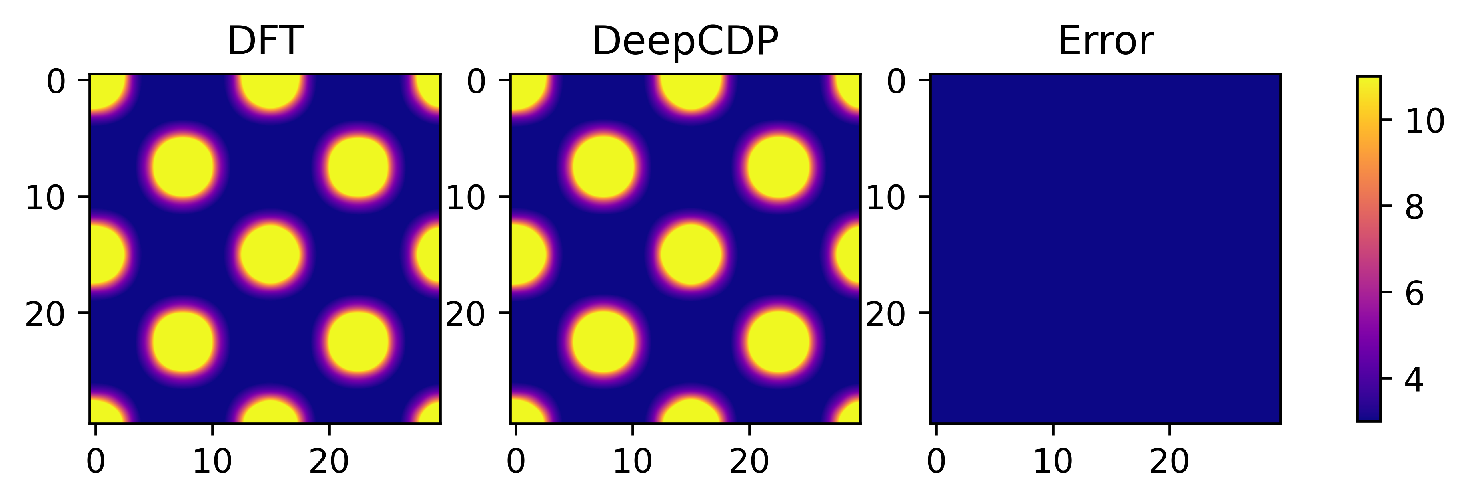
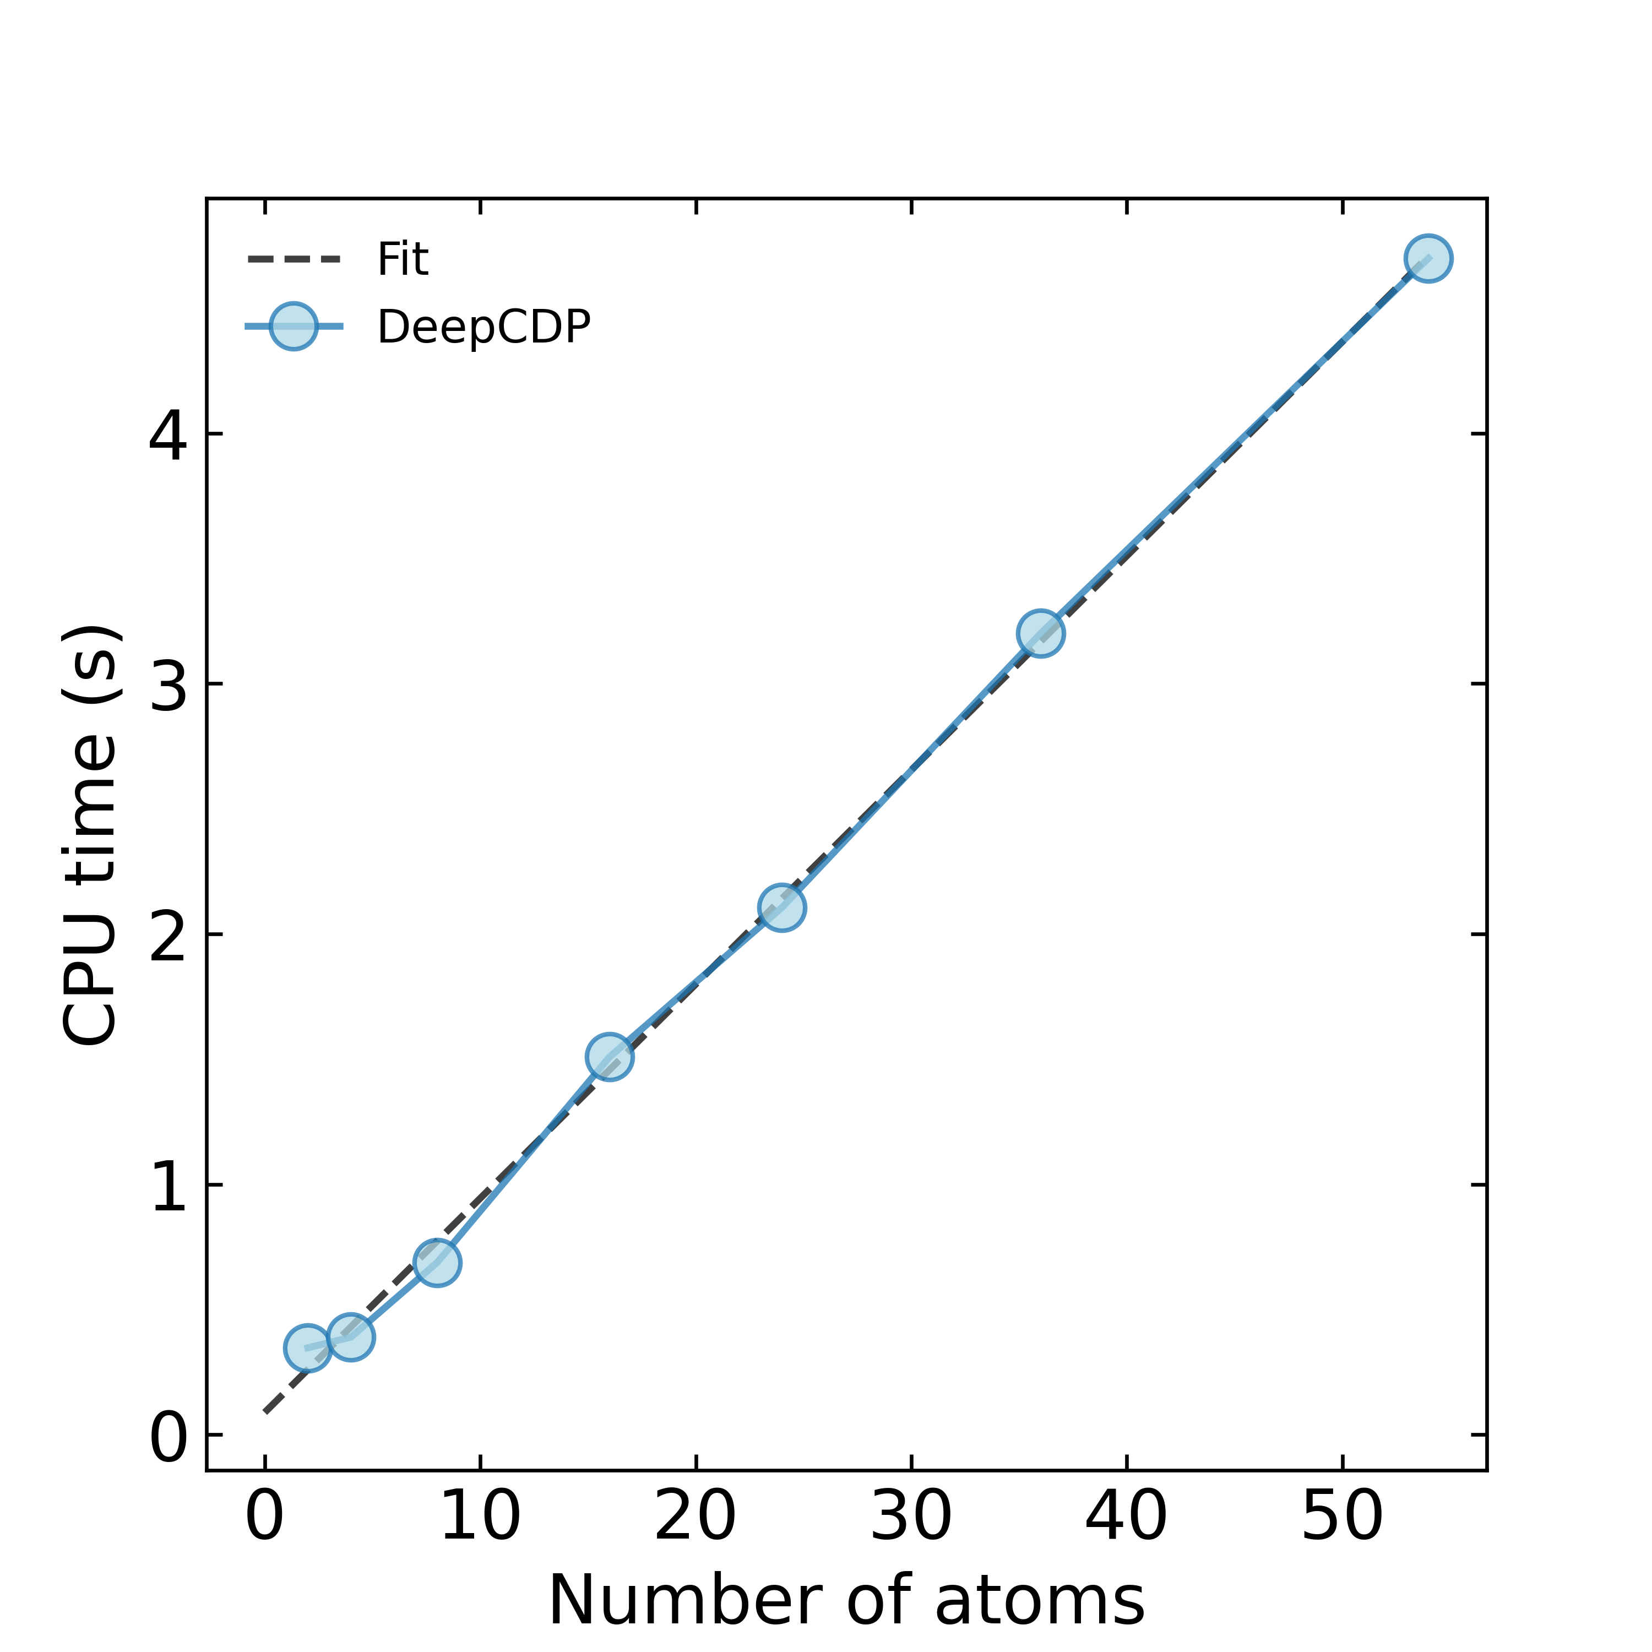
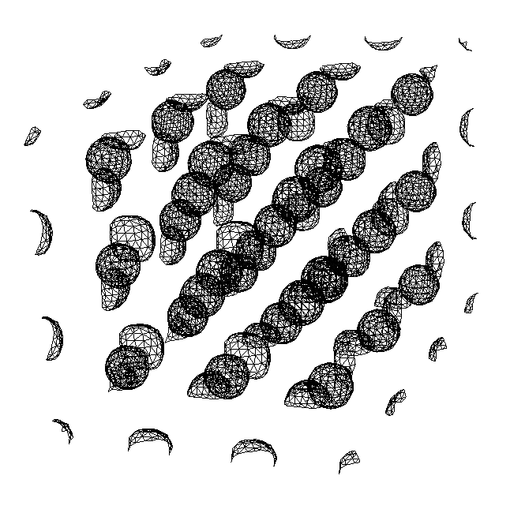
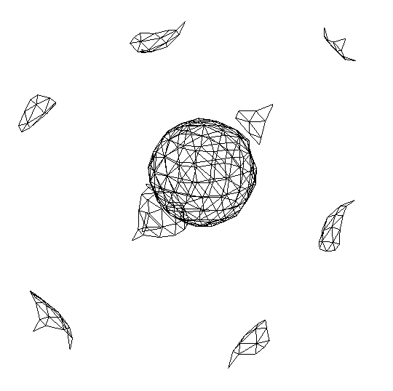
(a)
(b)
N = 54
N = 2
(N)

Slide 11
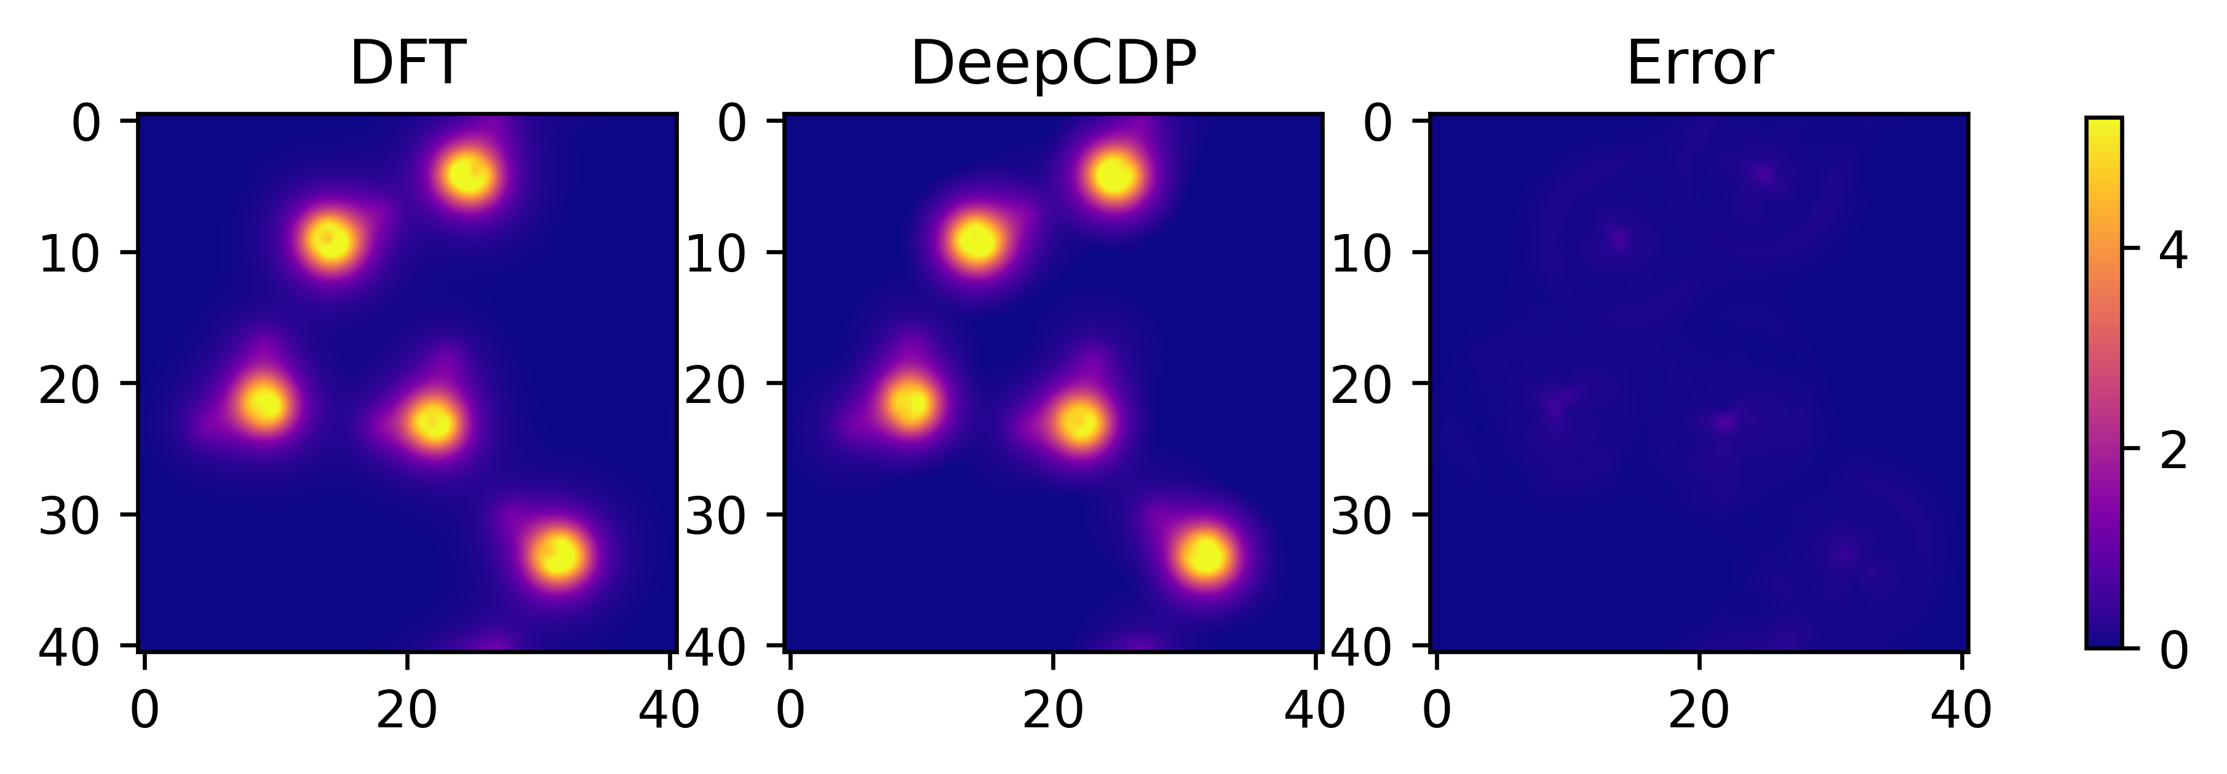
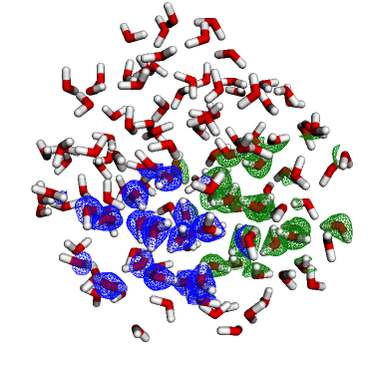
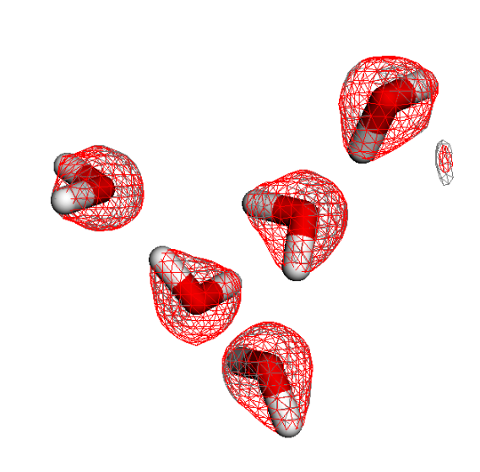
(a)
(b)
(c)

Slide 12
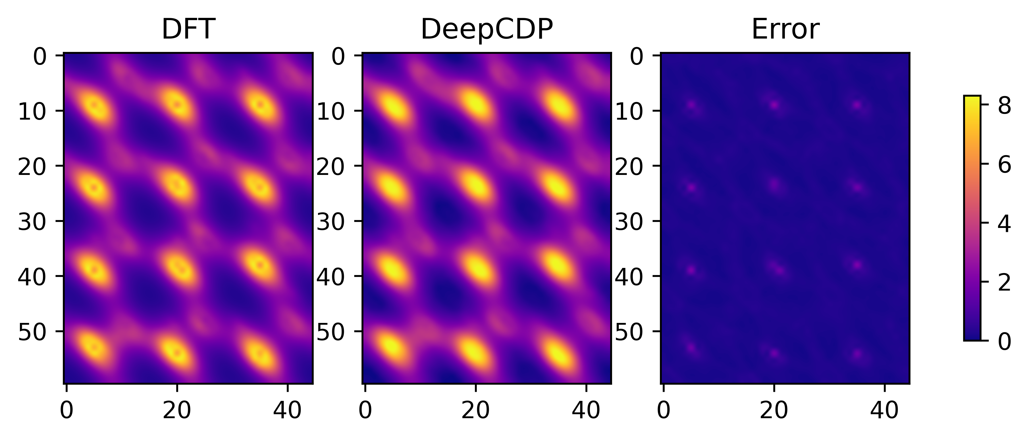
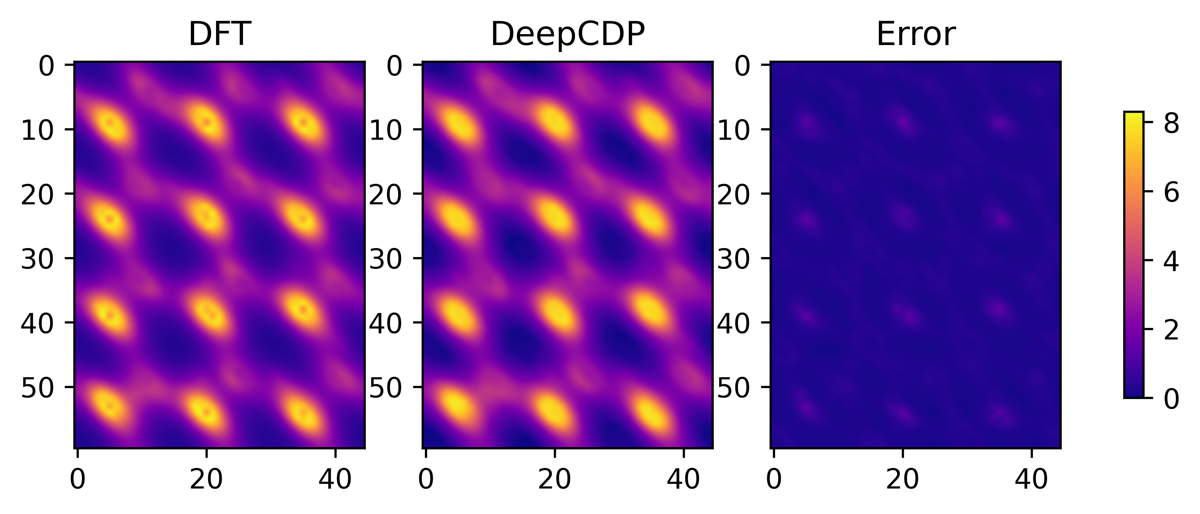
(a)
(b)
DeepCDP (u24C)
(c)
DeepCDP (c24C)

Slide 13
(a)
(b)
DeepCDP (u24C)
(c)
DeepCDP (c24C)

Slide 14
